Slide 1

Analyzing the Top Hits
Spotipy
Featured Artist: The Janitors | Cam Foster, Anis Ali, Michael Alread, & Ida Astaneh
Release Date: 2020 – 10 – 27

Slide 2
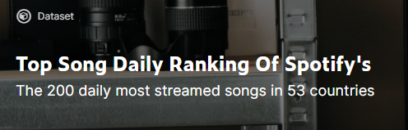


t h e o r i g i n a l d a t a
With over a million rows of data, The Janitors had their work cut out for them.
The original data set featured the top 200 streamed songs daily for 13 full months (starting on January 1, 2017) spanning across 17 countries around the world.
Given this information, our group started to wonder how we could effectively “clean” the data using the tools learned in class to come to meaningful conclusions.

Slide 3
q u e s t i o n s
Data Headers:
Position
Track Name
Artist
Streams
Date
Bins
Unique Track ID
Album
Release Date
Length
Popularity
Danceability
Acousticness
Energy
Instrumentalness
Liveness
Loudness
Speechiness
Tempo
Given the data provided, is there a direct correlation between our Spotipy headers?
Could we bucket the stream counts to show the percentage breakdown? How “popular” is popular?
Which artist/album appears the most and least amount of times on the list?
What decade, prior to 2010, was responsible for providing the most streams in 2017?

Slide 4
h y p o t h e s i s
Before analyzing the data, our group collaborated to hypothesize the following:
If the rank of the Track Name is higher, does that mean that the stream count is larger?
If an artist appears on the list more frequently, does that mean the stream count is larger?
If the release of the track is newer, does that mean the stream count is larger?
If the artist has multiples albums on the list, does that mean the stream count is larger?

Slide 5

c l e a n i n g t h e d a t a
Given the sheer volume of information provided, we knew we wanted to “clean” as much as possible to give ourselves a small subset of the data.
Using the tools from class, our base data has a combination of the Spotify API to bring in additional columns, US data in 2017, and the trimmed version to exclude erroneous Track Names and Artists.

Slide 6
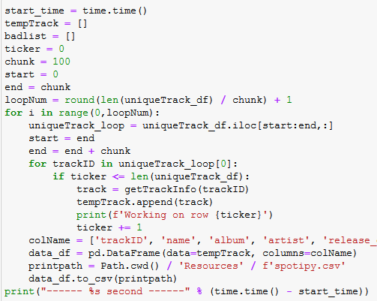
s p o t i f y A P I
Use the python library spotipy to interact with the Spotify API
Steps
Load US data in 2017 and found unique tracks
Created a loop to call the spotipy API for all tracks
Output the data and merged on Track ID with US data in 2017
Spotipy.audio_features()
Danceability | Describes hour suitable a track is for dancing (0-1)
Acousticness | A measure from 0-1 of whether the track is acoustic
Energy | A measure from 0-1 and represents a perceptual measure of intensity and activity
Instrumentalness | Predicts whether a track contains no vocals. 0-1, with 1 having a greater likelihood of no vocal content
Liveness | Detects the present of an audience in the recording
Loudness | The overall loudness of a track in decibels
Speechiness | Speechiness detects the presence of spoken words in a track. 0-1, with closer to 1 representing more exclusively speech-like recording (i.e. talk show, audio book, poetry)
Tempo | The overall estimated tempo of a track in beats per minute
Spotipy.Track()
Name | Track Name
Album | Album the Track appears on
Artist | Artist
Release Date | Release date of the Track Name
Length | Length of the Track in milliseconds
Popularity | Popularity (0-100)

Slide 7
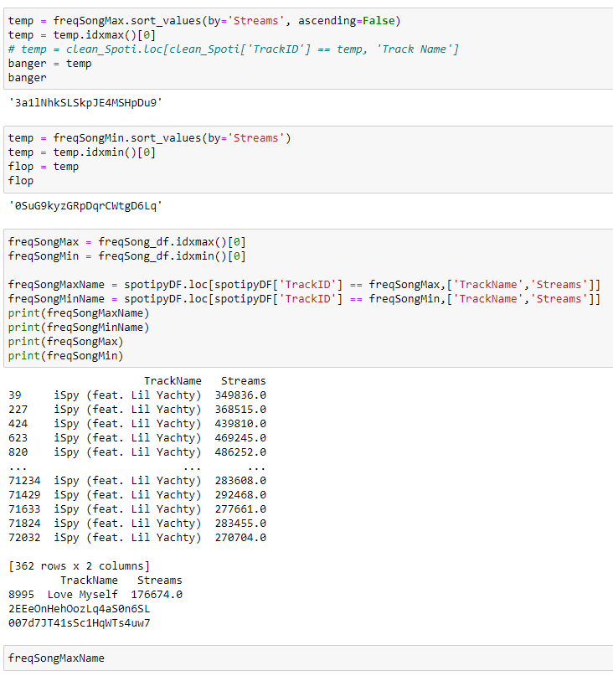
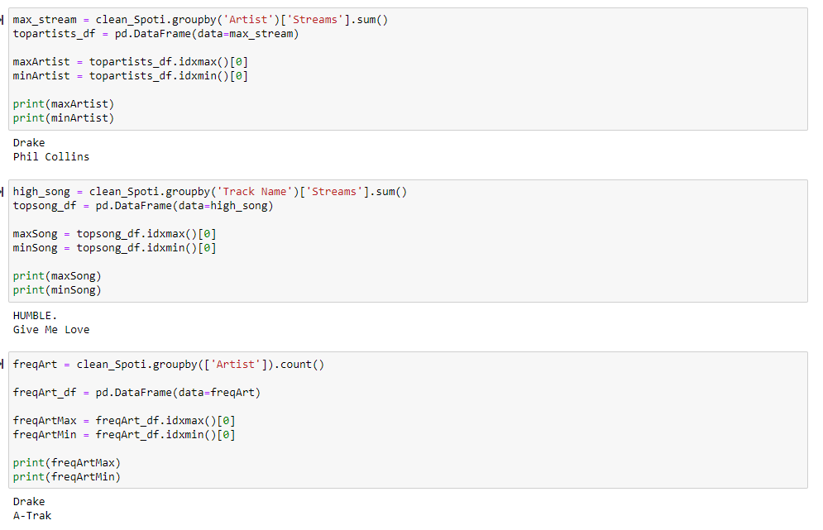
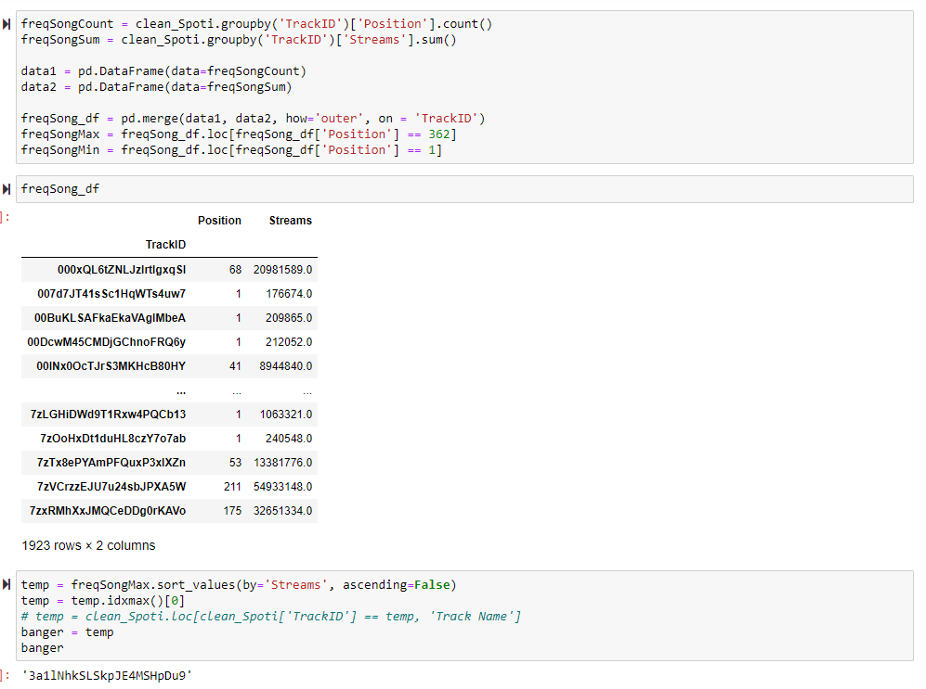
c l e a n i n g t h e d a t a

Slide 8
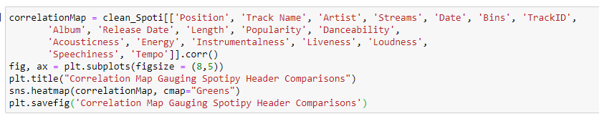
c o d e

Slide 9
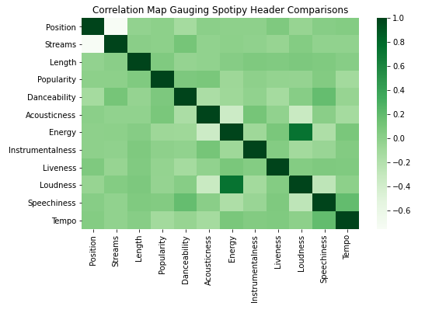
o u r g r a p h s
Correlation Map
Using all data headers, The Janitors wanted to create a correlation heat map with the headers as both the x and y axis.
Based off the data shown, you can clearly see that there is a strong, positive correlation between the ‘Energy’ and ‘Loudness’ of a song.
Inversely, there is a strong negative correlation between the ‘Position’ and the ‘Streams’. This means that as the rank of the song increases, the stream count decreases.

Slide 10
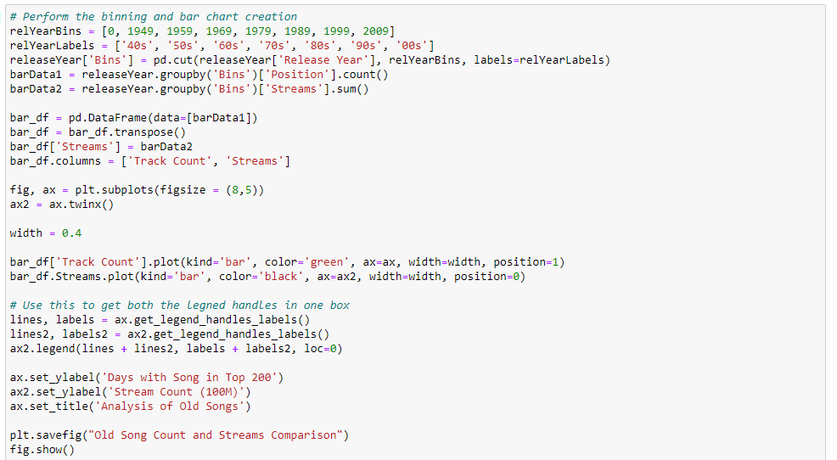
c o d e

Slide 11
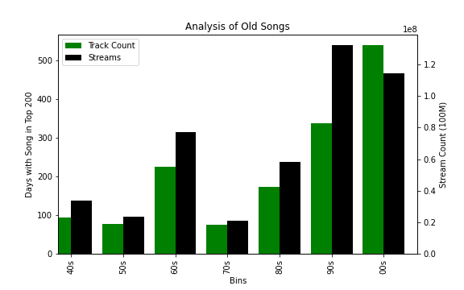
o u r g r a p h s
Analyzing Stream Count by Decades
Because our data was predominantly featuring songs from the 2000s, rows were filtered to eliminate bias and skewed information.
While the track count was the highest in 00s, The Janitors can see that the number of streams was larger across the board in all decades.
One can conclude that there is not necessarily a direct tie with stream to track count.

Slide 12
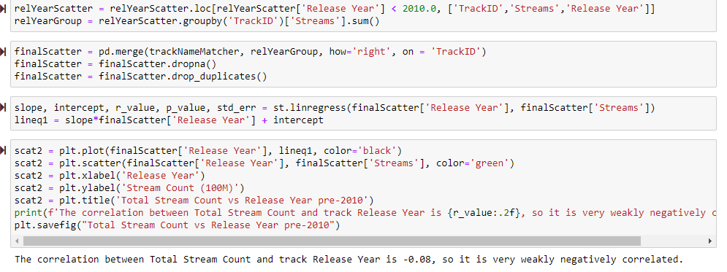
c o d e

Slide 13
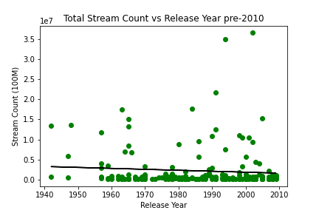
o u r g r a p h s
Stream Count by Release Year
Based off the data represented in the correlation map, The Janitors can conclude that there is a weak (to no) correlation tied between the stream count as the years progress.
In contrast to our previous graph, there are several outliers causing our data points to skew.
Theoretically, one would conclude that with modern technology and booming streaming industry, the stream counts would directly tie as the years progress.

Slide 14
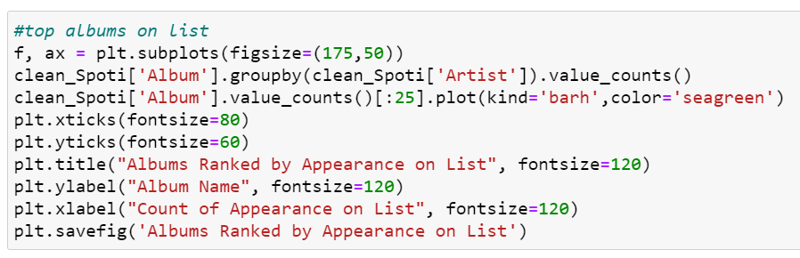
c o d e

Slide 15
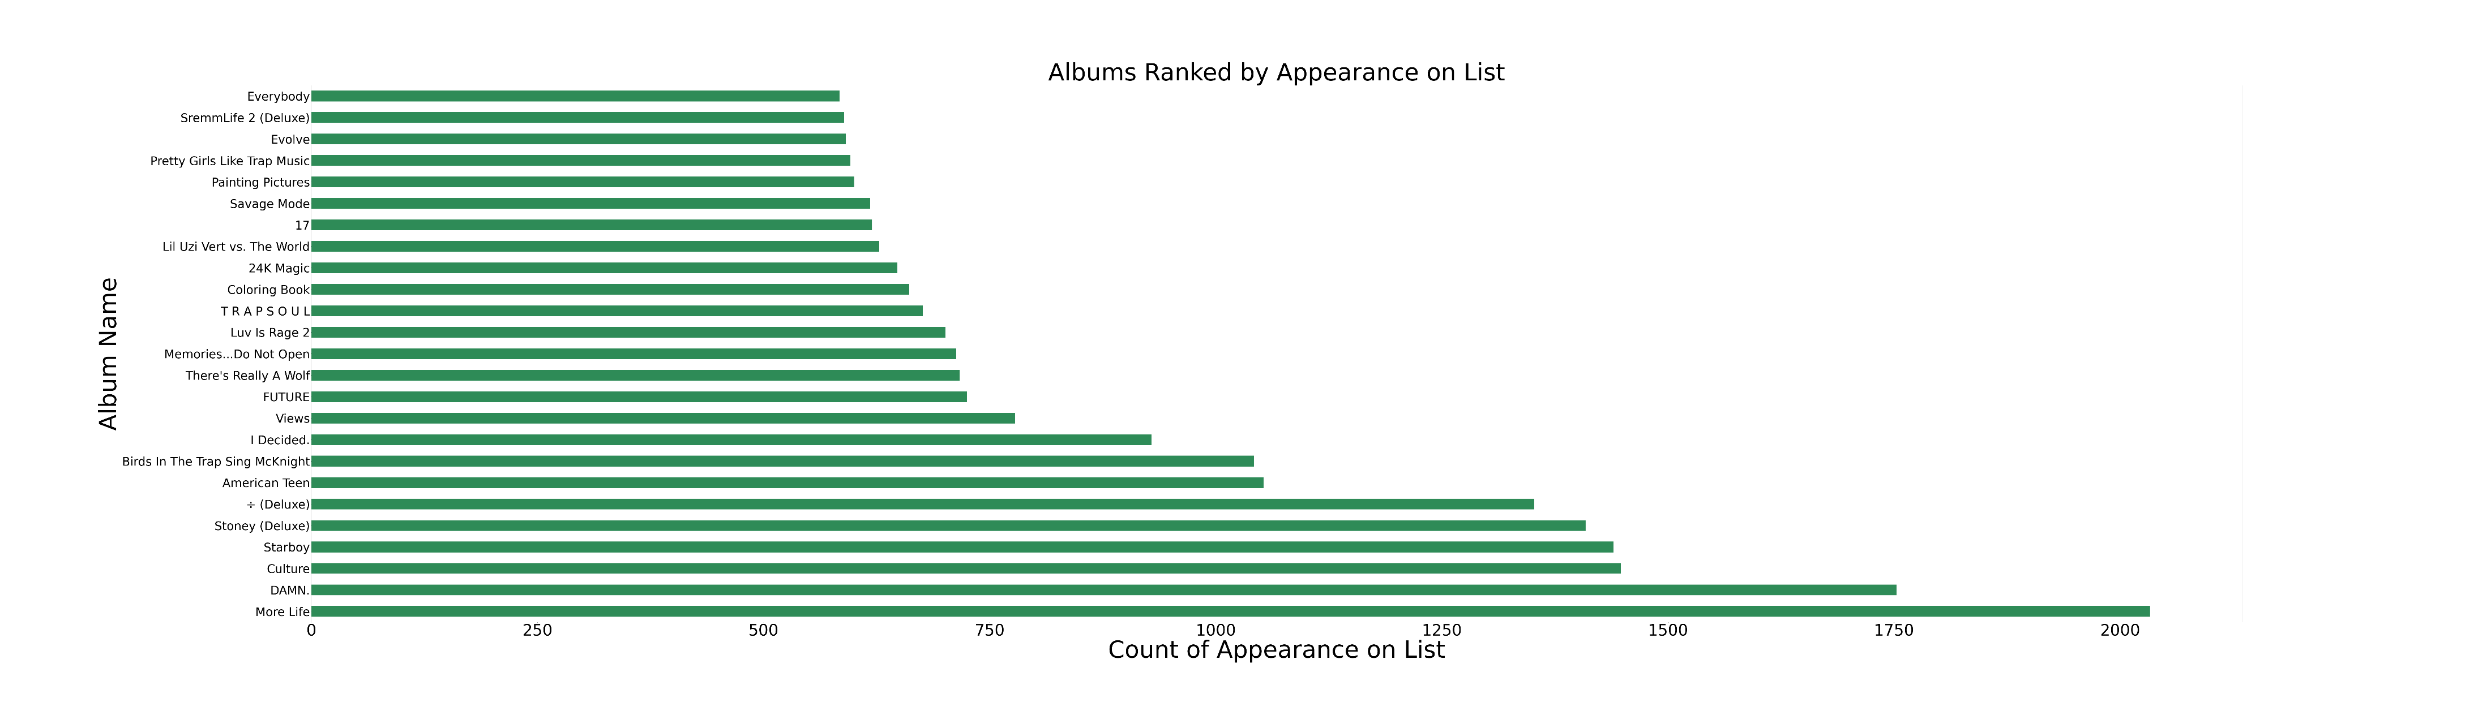
o u r g r a p h s
Albums Ranked by Appearance on List
With this particular graph, we want apply our questions to determine how popular an album was within the Top 200 list.
We questioned a couple things, with album frequency having direct effects with the count of streams as one part of our hypothesis.
This graph shows us that the top album that populated in our data was “More Life” at over 2000 appearances. With around 73k rows of data, that means that the album only had a placement rate of 2.7%.

Slide 16
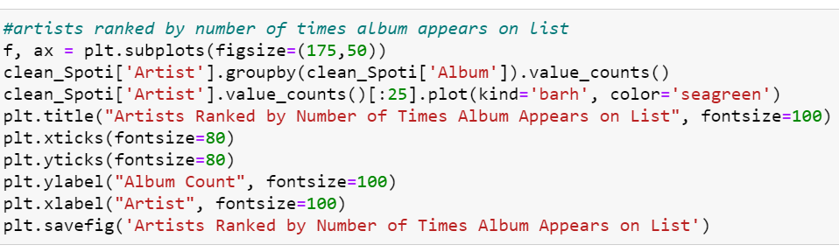
c o d e

Slide 17
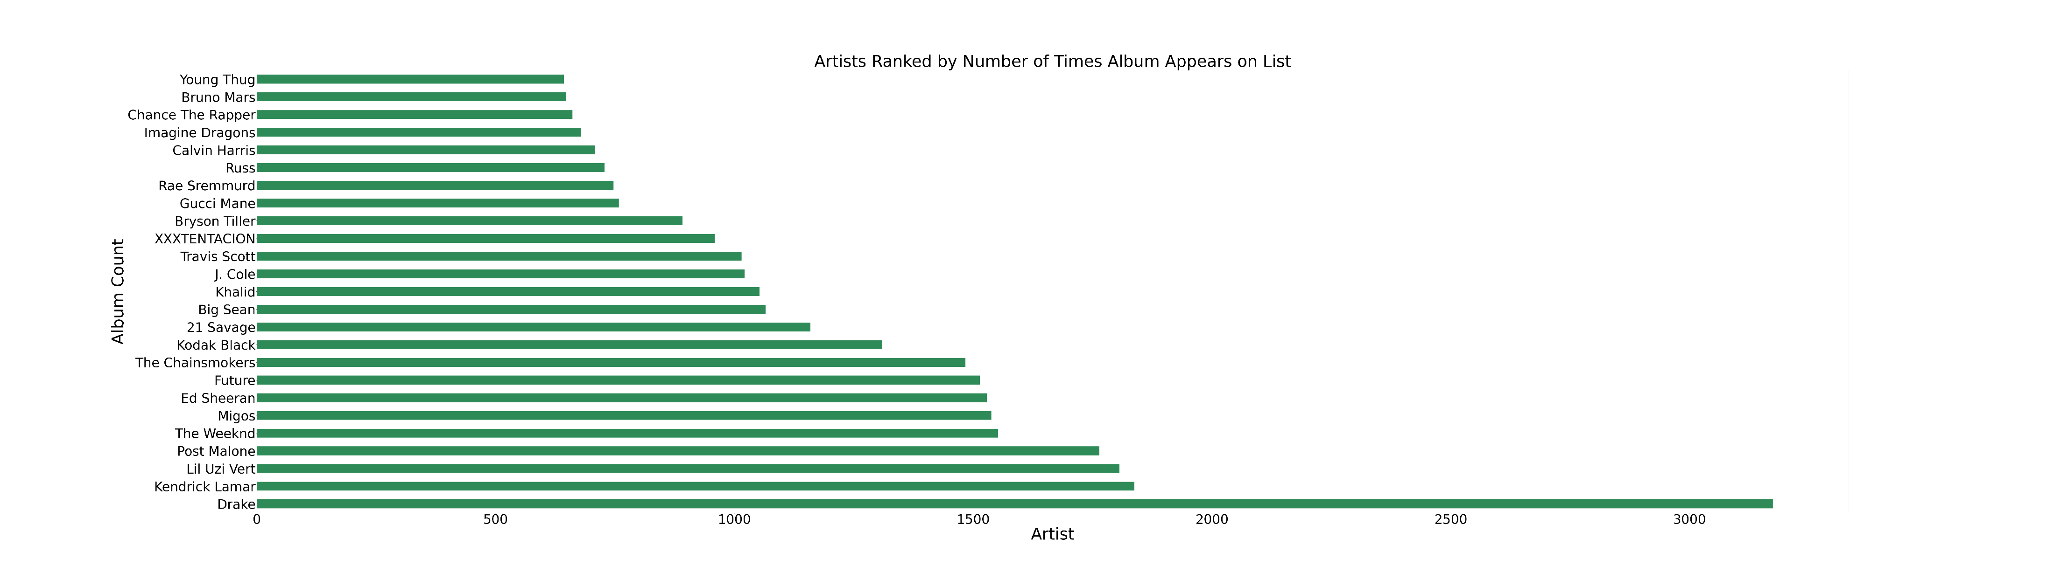
o u r g r a p h s
Artists Ranked by Album Appearance
After running a graph that compares the album count and streams, our team questioned whether the top artist automatically had the top album. In most cases, artists have multiple albums within the list.
Our previous graph in comparison to this graph:
Top Artist: Drake ☑
Top Album: More Life ☑
Second Artist: Kendrick Lamar ☑
Second Album: DAMN. ☑
Third Artist: Lil Uzi ☑
Third Album: Culture ☑

Slide 18
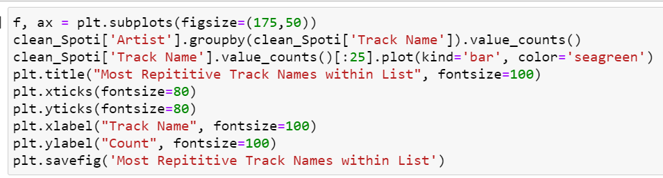
c o d e

Slide 19
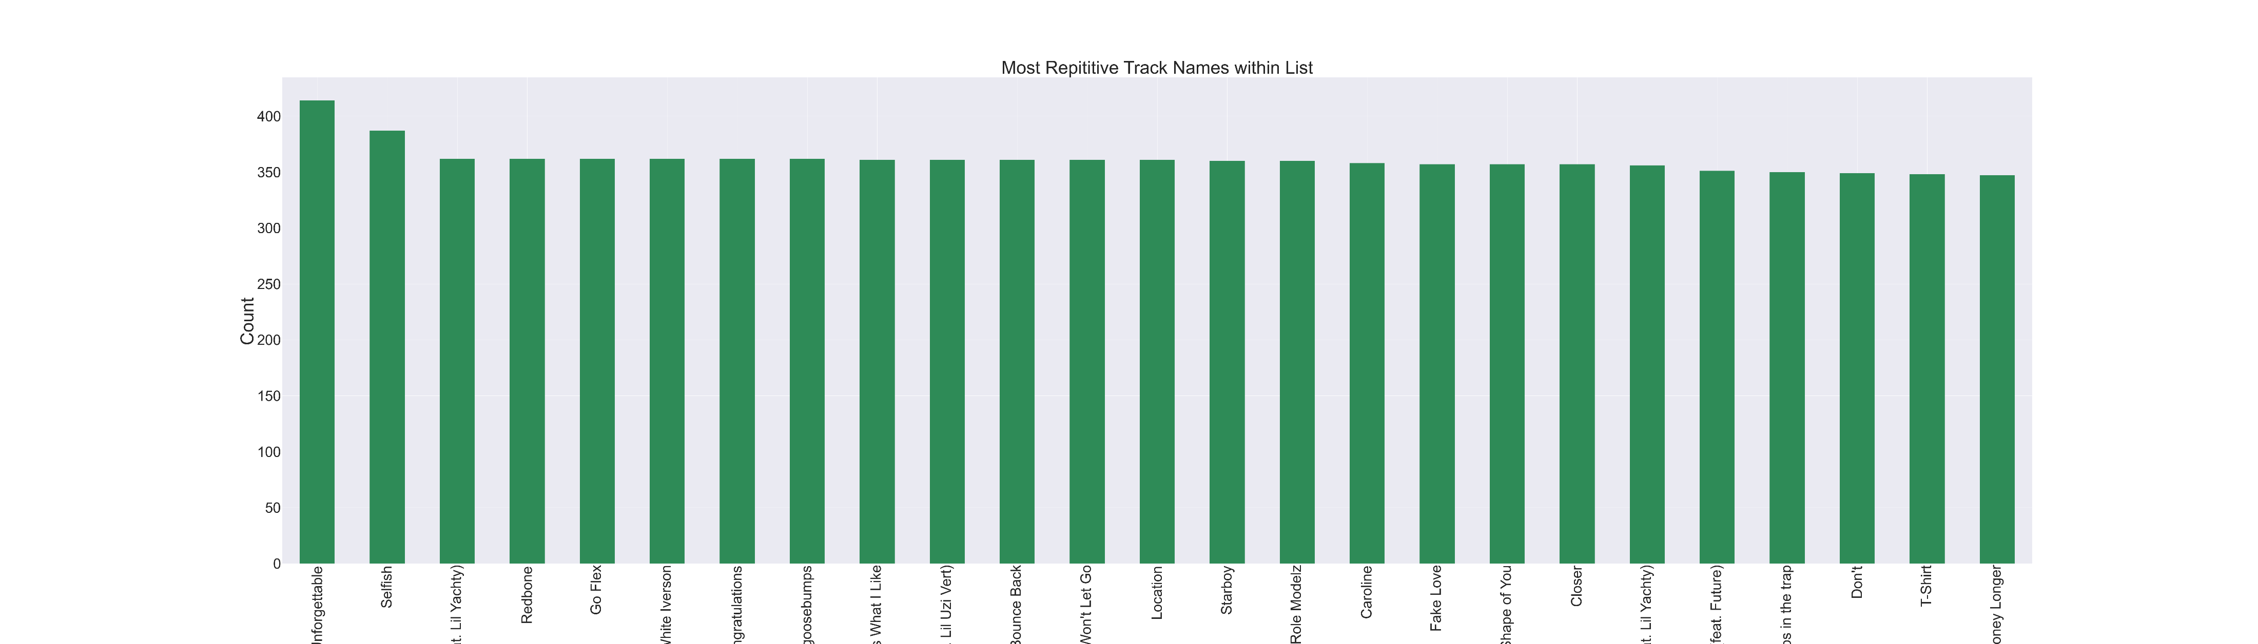
o u r g r a p h s
Most Repetitive Track Names
Continuing on analyzing our data, we asked ourselves whether the top artist correlated to the most repetitive tracks.
As we have uncovered, Drake was our most streamed artist, however, you can see that the most REPETITIVE name on the list was Unforgettable by French Montana.
We can conclude that just because the Track Name appears more frequently, it doesn’t necessarily mean that the song was streamed as much.

Slide 20
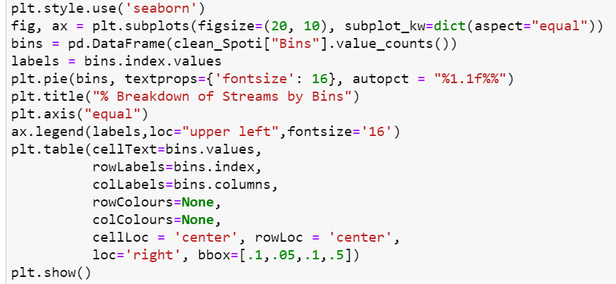
c o d e

Slide 21
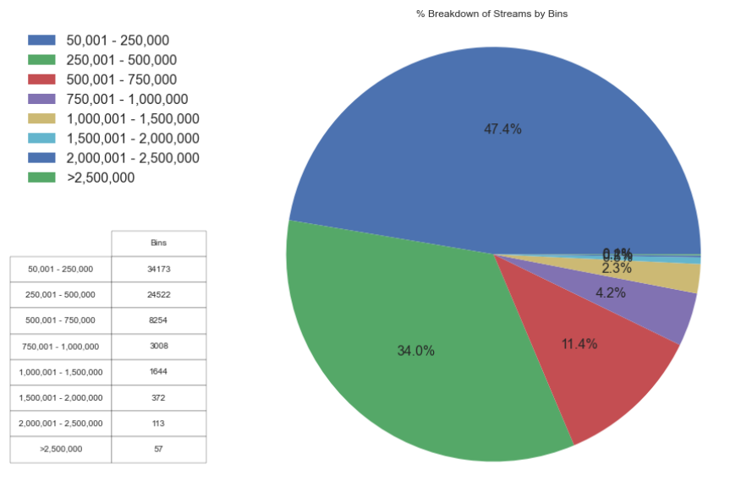
o u r g r a p h s
Creating Bins for Streams
Because we had so many “duplicative” results for artists streamed on a daily basis, our team created “bins” that would help us separate and decipher between the buckets.
As you can see in the graph, our largest percentage of streamed “bins” came from songs that were streamed in the “50,001 – 250,000 Streams” bucket.
By looking at this pie graph, The Janitors can conclude that more songs are being streamed at “lower” frequencies rather than “higher”.

Slide 22
c o n c l u s i o n
Based off the data provided, The Janitors can conclude that:
Number of streams has a direct correlation to the position rank
Artist frequency on the list equates to higher streaming volumes
As the years progress, the number of streams per artist do not tie exactly.
Because an artist has multiple albums within the list, it does correlate that their overall stream count will be higher.

Slide 23

s o n g o v e r . q u e s t i o n s ?

